Slide 1
Normalization
In the previous chapter we came up with a logical data model. We did this by designing ER diagrams that represented the logical data models.
The ER diagrams represent the logical design. It is not enough to come up with a logical design, we need to ensure that the logical design is an accurate representation of the data, its relationships, and constraints.
Normalization is the tool that is used to validate and improve a logical design.
Normalization is defined as the process
of decomposing relations with anomalies to produce smaller, well-structured relations

Slide 2
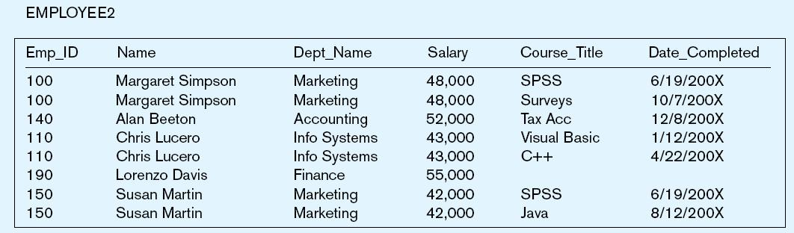
Example 1
The entity below was created to store data about courses taken by employees in an organization
Anomalies:
Insertion– Enter a new employee
Employee must take a class
Deletion– Remove employee 140
Lose information about the existence of a Tax Acc class
Modification– Give a salary increase to employee 100
Update multiple records
  How can we fix this??????

Slide 3
  We have this problem because there are two entities in this one relation.
  This results in data duplication and an unnecessary dependency between the entities.
  Often you will not discover this problem when you are designing your ERDs in the logical design. This phase only allows you to identify entities.
  After coming up with your entities you need to normalize them to get rid of such anomalies.

Slide 4
Well-Structured Relations
A relation that contains minimal data redundancy and allows users to insert, delete, and update rows without causing data inconsistencies
A poorly structured relation ship has the following anomalies
  Insertion Anomaly–adding new rows forces user to create duplicate data
  Deletion Anomaly–deleting rows may cause a loss of data that would be needed for other future rows
  Modification Anomaly–changing data in a row forces changes to other rows because of duplication

Slide 5
Normalization Process
Normalization is the process for assigning attributes to entities to:
  Reduces data redundancies
  Eliminate data anomalies
Often executed as a series of steps. Each step corresponds to a specific normal form, which has known properties.

Slide 6
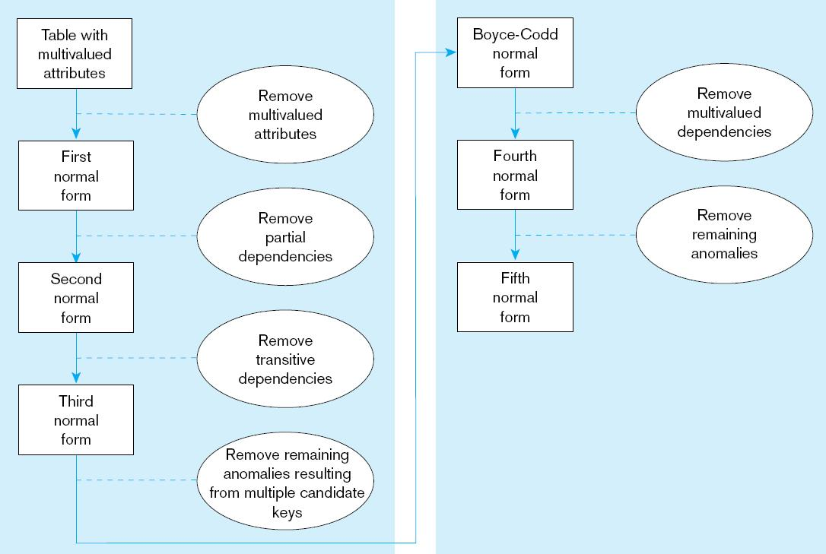
Steps in normalization

Slide 7
Normalization Forms
Four most commonly used normal forms are first (1NF), second (2NF) and third (3NF) normal forms, and Boyce–Codd normal form (BCNF).
These are the forms that we shall focus on.
A relation can be normalized to a specific form to prevent anomalies.

Slide 8
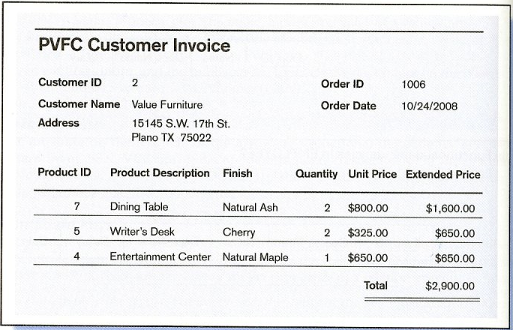


Slide 9
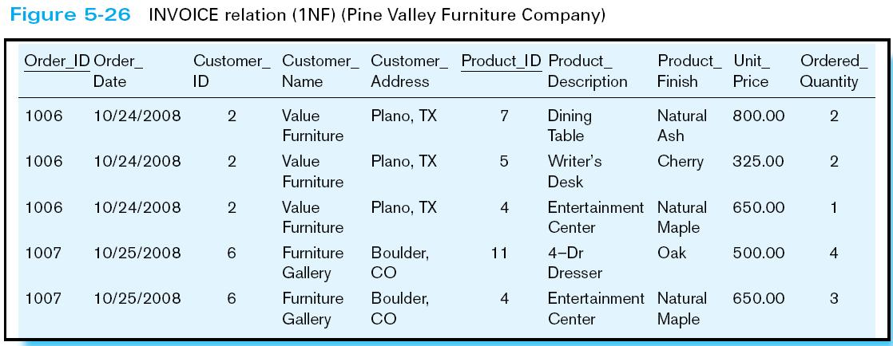
1. Unnormalized Form (UNF)
A table that contains one or more repeating groups such as the one below.

Slide 10
2. First Normal Form (1NF)
A relation in which intersection of each row and column contains one and only one value. There is no data duplication.
To fix this identify the key for the un-normalized table.
An entity is said to be in 1NF if:
  All key attributes defined
  No repeating groups in table
  All attributes dependent on primary key

Slide 11
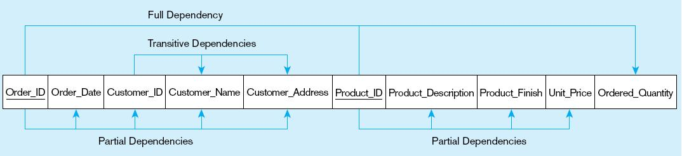

Slide 12
3. Second Normal Form (2NF)
A relation is said to be in 2NF if it is in 1NF and has no partial dependencies
To ensure that a relationship is in the 2NF
  Ensure it is already in 1NF.
  If partial dependencies exist on the primary key remove them by placing them in a new relation along with copy of their determinant (primary key).

Slide 13
Order_ID ➔ Order_Date,
Product_ID ➔ Product_Description, Product_Finish, Unit_Price
Order_ID_Product_ID ➔ Order_Quantity, Customer_ID,Customer_Name, Customer_Address

Slide 14
4. Third Normal Form (3NF)
3NF - A relation that is in 1NF and 2NF and in which no non-primary-key attribute is transitively dependent on the primary key.
To fix this, if transitive dependencies exist on the primary key remove them by placing them in a new relation along with copy of their determinant.

Slide 15
Order_ID ➔ Order_Date,
Product_ID ➔ Product_Description, Product_Finish, Unit_Price
Order_ID_Product_ID ➔ Order_Quantity ,Customer_ID,Customer_Name, Customer_Address
Transitive dependence
Order_ID ➔ Order_Date,
Customer_ID ➔ Customer_Name, Customer_Address
Product_ID ➔ Product_Description, Product_Finish, Unit_Price
Order_ID_Product_ID ➔ Order_Quantity

Slide 16
Exercise: Table Employee has the following attributes:
  PROJ_NUM
  PROJ_NAME
  EMP_NUM
  EMP_NAME
  JOB_CLASS
  CHG_HOURS
  HOURS
  Is this relationship in the 1NM?
  Is this relationship in the 2NM?
  Is this relationship in the 3NM?

Slide 17
Solution
INF
ASSIGN - (PROJ_NUM, EMP_NUM, HOURS)
PROJECT - (PROJ_NUM, PROJ_NAME)
EMPLOYEE - (EMP_NUM, EMP_NAME, JOB_CLASS)
JOB - (JOB_CLASS, CHG_HOUR)
2NF
3NF

Slide 18
Example
Consider the relations below:
  STUD_ID COURSE_ID DEPT GRADE
  625423 IST1010 IST B+
  623344 HRM2010 HRM C+
  624545 IST2010 IST B
  628758 BUS3010 IBA A
Assume the primary key is a composite key made up of STUD_ID and COURSE_ID
This relationship is already in 1NF since we do not have any repeating groups
This relationship is already in 2NF since we do not have any partial dependencies
This relationship is already in 3NF since we do not have any transitive dependencies

Slide 19
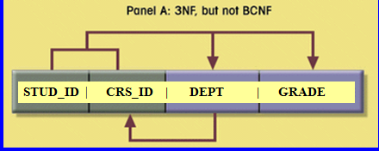
A closer examination reveals that while department does not depend on course ID (thus no partial dependencies), COURSE_ID depends on DEPT.
A solution would be to separate the tables as follows:
  STUD_ID-DEPT GRADE → 1. replace CID with DEPT
  DEPT CRS_ID → 2. Create another entity with CID in it and DEPT as the PK

Slide 20
5. Boyce–Codd normal form (BCNF)
BCNF is an extension of 3NF
For 3NF a fully functional dependency is where the primary key A → B. If B determines part of the primary-key attribute then 3NF will allows this dependency.
Whereas, BCNF insists that for this dependency to remain in a relation, a non key attribute must not determine part of the primary key.
Every relation in BCNF is also in 3NF. However, relation in 3NF may not necessarily be in BCNF.
A relation is in BCNF if and only if every determinant is a candidate key.

Slide 21
Violation of BCNF is quite rare.
Potential to violate BCNF may occur in a relation that:
  contains two (or more) composite candidate keys;
  the candidate keys overlap (i.e. have at least one attribute in common).

Slide 22
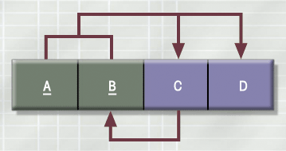
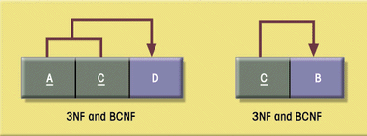
This problem is solved as follows:

Slide 23
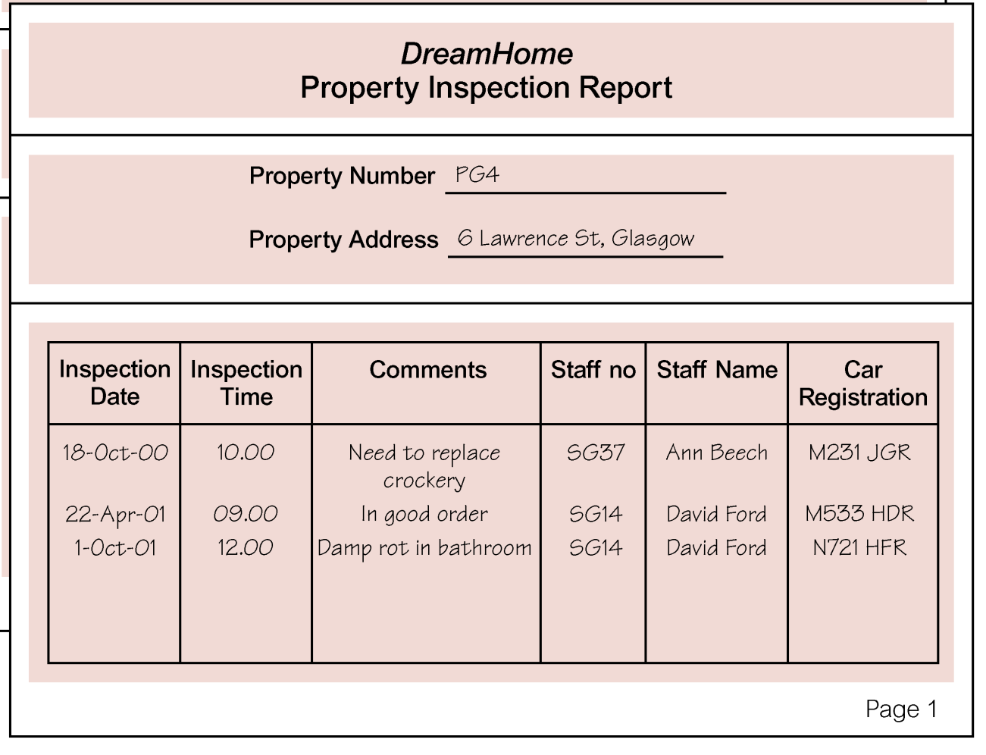
Example – Normalization to BCNF

Slide 24
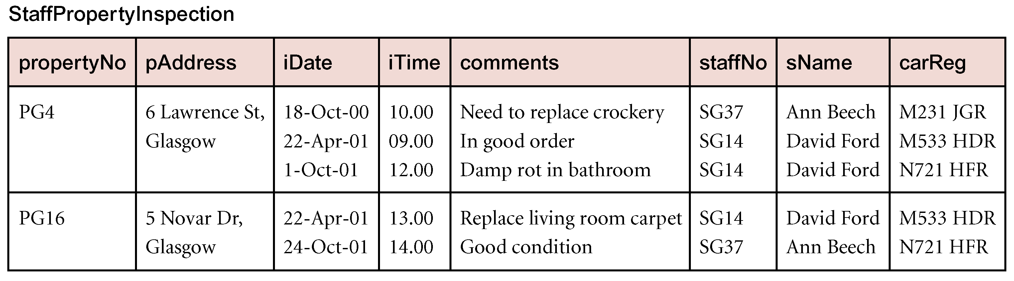
UNF

Slide 25
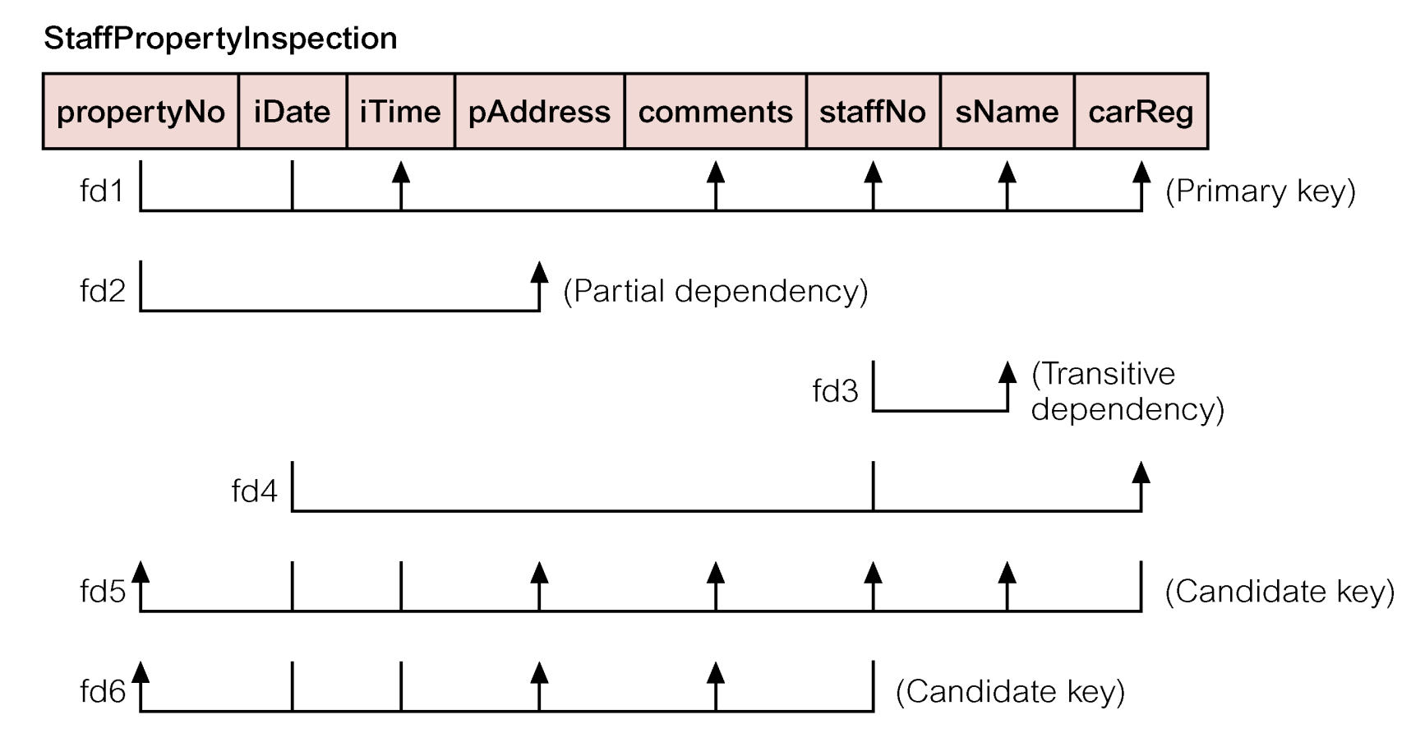
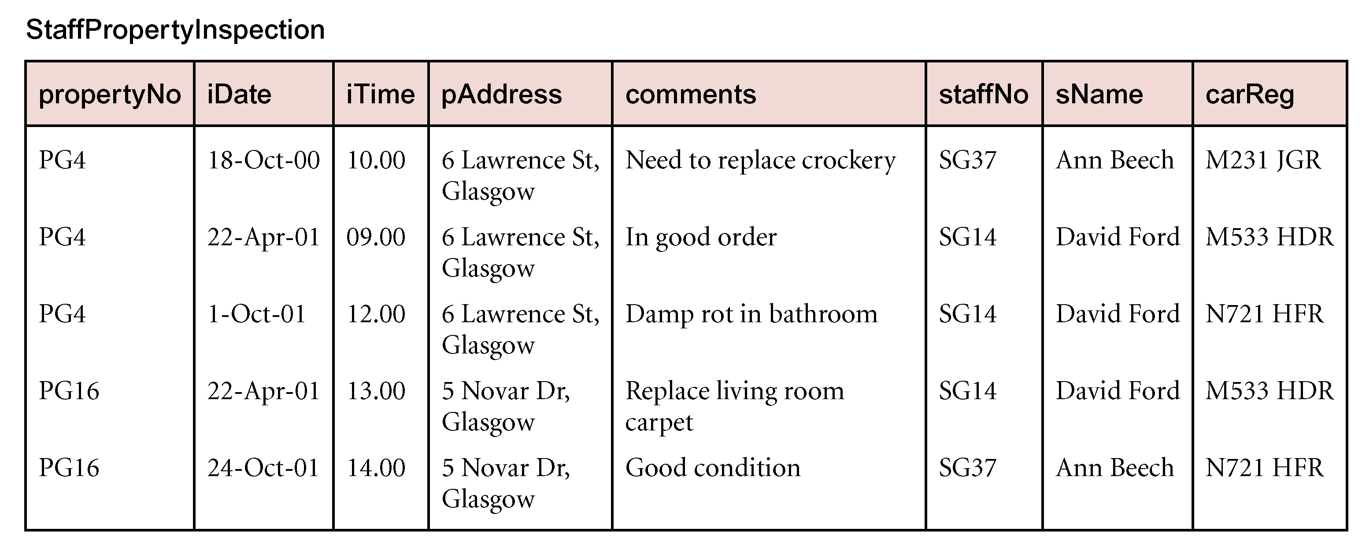
1NF - Identify primary key to remove repeating groups
Property No - iDate

Slide 26
2NF – Identify partial dependencies
Remove them as follows:
  propertyNo pAddress
  propertyNo-iDate iTime comments staffNo sName carReg

Slide 27
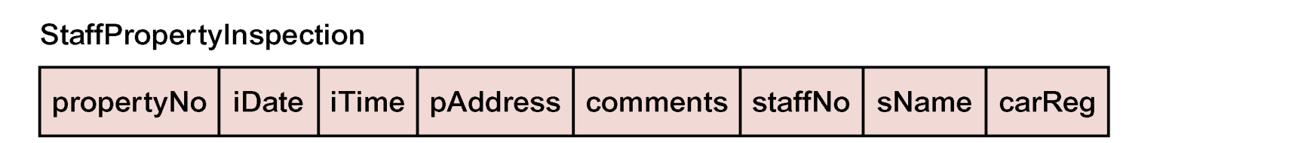

3NF – identify transitive dependencies
Remove them as follows:
  propertyNo pAddress
  propertyNo-iDate tTime comments
  staffNo sName carReg

Slide 28
BCNF – Identify determinants that are not candidate keys
Remove them as follows:
  propertyNo pAddress
  propertyNo-iDate tTime comments propertyNo staffNo
  staffNo sName
  carReg staffNo

Slide 29
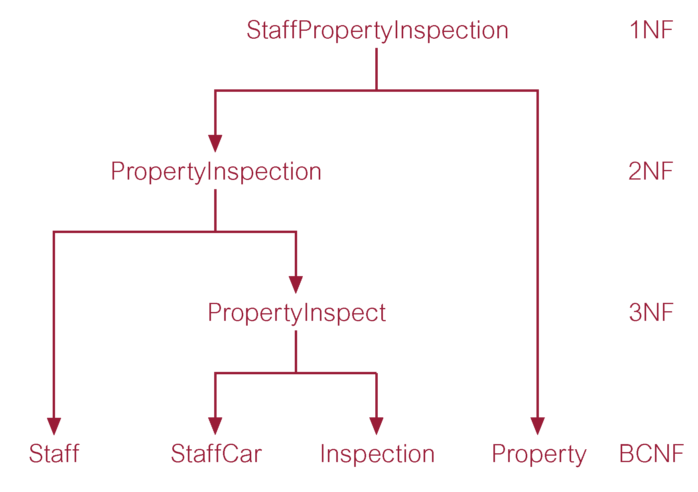

Slide 30
Denormalization
While normalization is one of many database design goals it is important to note that Normalized table result in
  Additional processing
  Loss of system speed
Normalization purity may also be difficult to sustain due to conflict in:
  Design efficiency
  Information requirements
  Processing
You may therefore have to de-normalize a normalized table so that you Can improve performance.

Slide 31
Common de-normalization opportunities
  Two entities with one-to-one relationship
  Extra table access required → Slow speeds

Slide 32
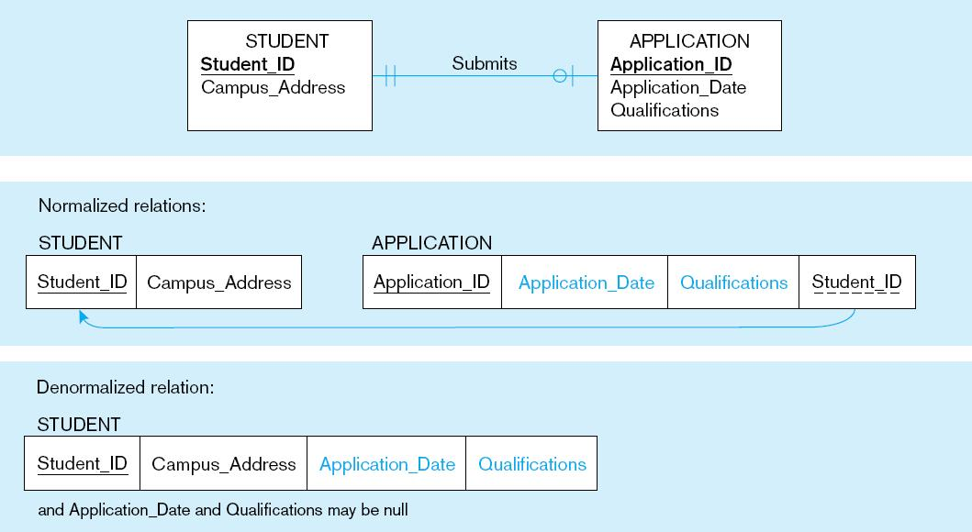
Two entities with one-to-one relationship

Slide 33
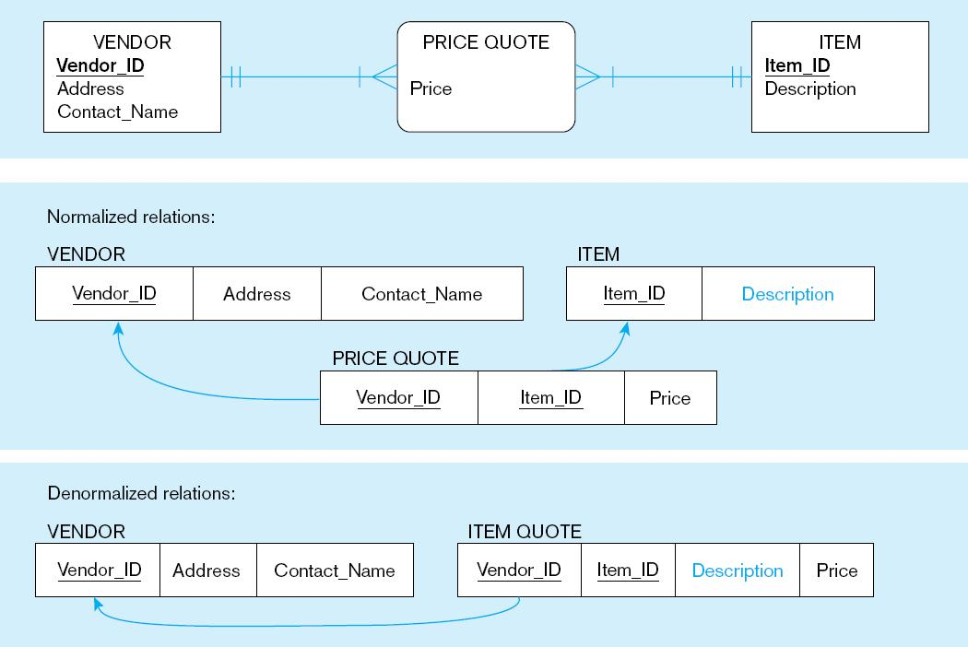
Extra table access required - Result of de-normalization will be a many-to-many relationship

Slide 34
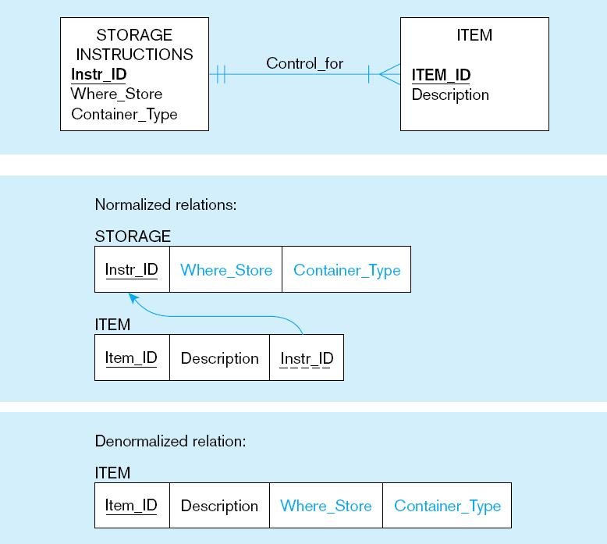
Extra table access required - Result of de-normalization will be data duplication

Slide 35

Exercise I
Normalize the Forms to the third normal form. Show the output of each form.
Create Entity relationship diagrams with attributes. Indicate the keys.

Slide 36
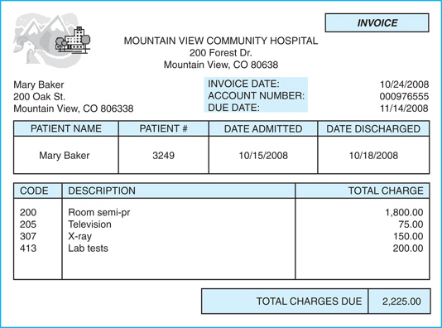
Exercise II

